Slide 1
Operating system in a banking system
PRESENTED BY:
M.SHARMILA
192524395

Slide 2
INTRODUCTION
An Operating System (OS) is system software that manages computer resources.
It acts as an interface between applications and hardware.
It supports thousands of banking transactions simultaneously.
It manages processes, memory, files, and input/output devices.
It provides security and protects sensitive banking data.
It ensures fast, reliable, and efficient banking operations.

Slide 3
PROBLEM IDENTIFICATION
Problem: Handling Thousands of Banking Transactions
Banks process thousands of transactions simultaneously.
Transactions include deposits, withdrawals, fund transfers, and balance enquiries.
The system must provide security, accuracy, and fast processing.
Multiple users must access shared resources without conflicts.
Solution: A reliable, secure, multitasking operating system.

Slide 4
TYPES OF OS SUITABLE FOR BANKING
Multi-user OS: Supports many users simultaneously.
Multiprocessing OS: Uses multiple CPU cores to execute tasks efficiently.
Multitasking OS: Handles several processes at the same time.
Distributed OS: Can coordinate resources across multiple computers.
Best choice: A secure multi-user, multitasking OS with multiprocessing support. Distributed systems may also be used across bank branches.

Slide 5
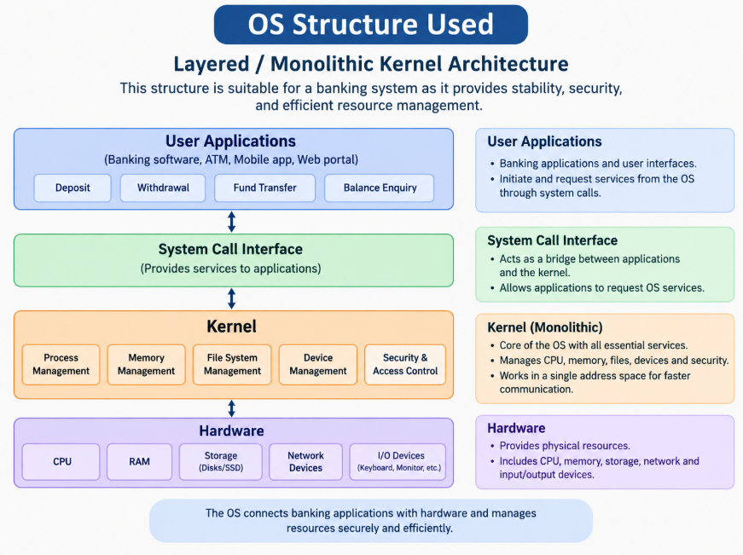
OS STRUCTURE USED

Slide 6
ROLE OF THE OS IN BANKING
Process management: Schedules multiple banking transactions.
Memory management: Allocates RAM to running applications.
File management: Organizes transaction logs and stored data.
Device management: Controls disks, network interfaces, and other devices.
Security: Enforces access permissions and isolates processes.
These functions improve efficiency, reliability, and data protection.

Slide 7
SYSTEM CALLS IN BANKING
Process Creation: fork() creates a new process to handle a banking task.
Program Execution: exec() runs the required banking application.
File Access: open() opens transaction files and logs.
Reading Data: read() reads account and transaction information.
Writing Data: write() records transaction details in files or logs.
Communication: send() and recv() help exchange data between banking services through sockets.

Slide 8
FUND TRANSFER STEPS
The customer requests a transfer.
The application verifies the customer's identity and permissions.
The banking software checks the account balance.
The database transaction debits one account and credits another atomically.
The transaction result is recorded and confirmation is displayed.
Important: Database transactions provide atomicity and consistency. The OS supports process execution, file and network I/O, and access control, but database software is responsible for transaction-level guarantees.

Slide 9
CONCLUSION
A suitable OS handles multiple banking operations efficiently.
The kernel manages CPU, memory, storage, and devices.
System calls connect applications to OS services.
Security and reliable database transactions help protect banking operations.
Future scope: Cloud computing, stronger cybersecurity, and fault-tolerant banking infrastructure.

Slide 10
THANK YOU

